Slide 1
COMP6230: Implementing Cybersecurity
Oli Bills
ofb@ecs.soton.ac.uk

Slide 2
In the news this week…

Slide 3
Yahoo confirms data breach of at least
500 million accounts

Slide 4
Safe browsing checks fail as 16,000 WordPress sites hacked this year

Slide 5
Wrong answer of the game!
Brought to you by
Just Say No!

Slide 6
Hacked Steam accounts spreading
malware

Slide 7
An introduction…

Slide 8
To cybersecurity!
What is it all about?
Electronic data
Abuse and misuse
Security is still an IT system
Technology
Procedures
People
And all of them are usually useless!

Slide 9
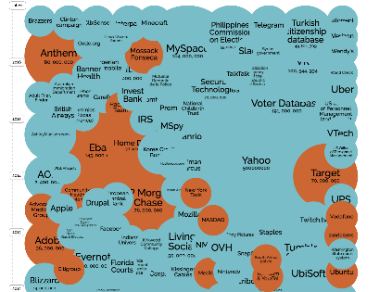
Who can you trust?
It’s getting rather hard…
http://www.informationisbeautiful.net/visualizations/worlds-biggest-data-breaches-hacks/

Slide 10
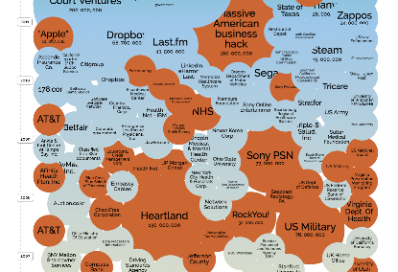
It goes on…

Slide 11
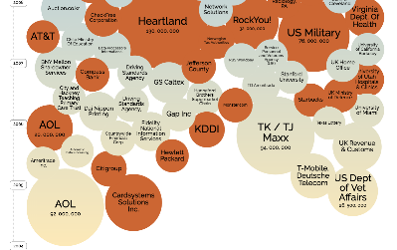
It goes on…

Slide 12
It goes on…
We are GETTING WORSE!
That’s why we now have modules like these…

Slide 13
To us!
No, not Us.
Ed Zaluska (Module Leader)
ejz@ecs.soton.ac.uk
Gary Wills
gbw@ecs.soton.ac.uk
Oli Bills
ofb@ecs.soton.ac.uk

Slide 14
To me!
Student at Southampton
Teaching Fellow, teaching Cybersecurity
But before…
I worked at Netcraft doing security consulting
I worked at the Students Union
I worked at iSolutions
And there was much sadness!

Slide 15
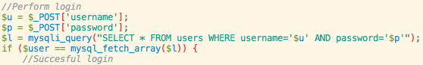
Much sadness
An application used by thousands of people daily
Still in use today
Still has this line in it today…

Slide 16
To me!
This is why I teach cybersecurity
I have a hope for a better future!
And you are it!
That in a few years time, these won’t be the weekly headlines
<x> loses a gazillion passwords
Millions of accounts compromised in breach at <y>
<z> shuts down following loss of all customer data

Slide 17

To COMP6230
We have a lot of excitement in store!
Principles of security
Security threats
Planning, analysis and risk
Security models
Computer forensics
Malware
Web application security
Penetration testing
Tools and techniques
Network security
Cryptography
Secure systems

Slide 18
To COMP6230
Our lectures
To introduce you to material
Tuesday 11am – 05/2015
Wednesday 1pm to 3pm – 05/2015
Our tutorial
To answer questions and go over things in depth
Will not be used every week – check the website
Thursday 12pm – 58/1009
Our labs
To turn theory into practice
Will not be used every week – check the website
Wednesday 3pm to 5pm – 59 Level 2 Lab

Slide 19
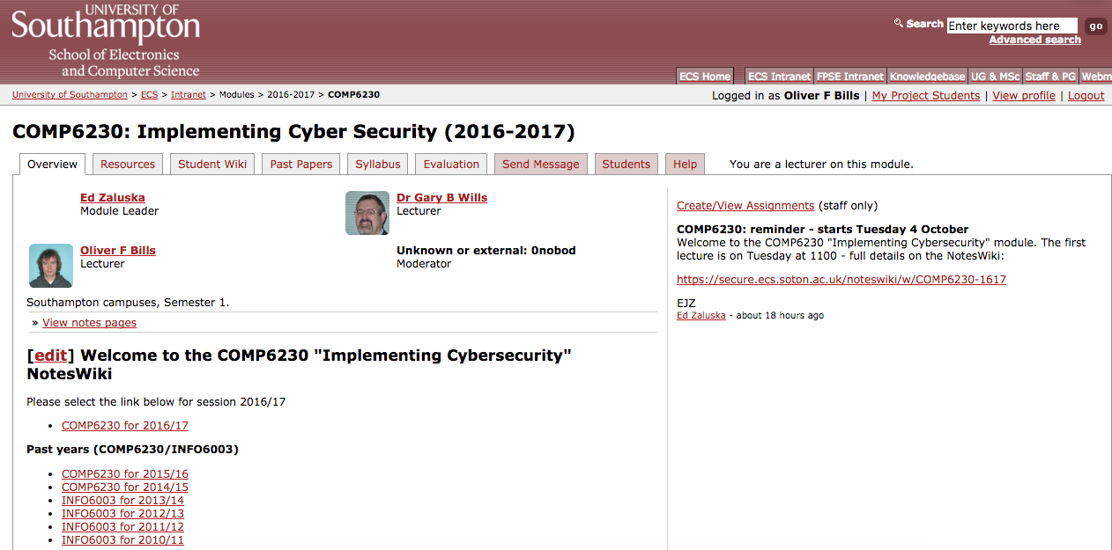
To COMP6230
Everything you need
https://secure.ecs.soton.ac.uk/module/comp6230

Slide 20
To COMP6230
11 hours of study per week on average
The lectures are just the beginning…
Read the additional resources and materials
Practice the tools and techniques
Complete the assignments
And start them before the deadline!

Slide 21
To COMP6230: Coursework
2 coursework assignments to put your theory into practice
Web-based penetration testing (20%)
Network-based penetration testing (30%)
And a 2 hour exam (50%)

Slide 22
To COMP6230: Coursework
Coursework 1: Web Security Testing
Set: Week 8
Due: Week 8
Coursework 2: Network Security Testing
Set: Week 11
Due: Week 11

Slide 23
To COMP6230: Coursework
Coursework 1: Web Security Testing
Set: Week 8 Week 5
Due: Week 8
Coursework 2: Network Security Testing
Set: Week 11 Week 8
Due: Week 11

Slide 24
Look out for each other
Everyone can get 100%
You are marked on what you achieve
You aren’t marked competitively
Working with and helping each other is encouraged
The best results come when you help each other
Share resources, ideas, tips, techniques
But your work must be your own
Helping someone isn’t doing it for them!

Slide 25
Communication and Support
Use the Facebook group
The first place to go to ask questions, talk, discuss
This is your space, but I’ll help!
https://www.facebook.com/groups/comp6230/
Course mailing list
comp6230@all.soton.ac.uk
Email the lecturers
ofb@ecs.soton.ac.uk - me
gbw@ecs.soton.ac.uk - Gary
ejz@ecs.soton.ac.uk - Ed
Labs, Tutorials, Talk to us!

Slide 26
Tell us your feedback!
Let us know how we’re doing!
Is it interesting?
Is it helpful?
Is there anything you’re not understanding?
Is too fast?
Is there anything we are missing?
Let us know and give us feedback!

Slide 27
We listen!
Practical assignments were fun, but we need more support
Added non-assessed mini exercises
Added more labs
Added more demonstrators
More lab-based practical work
Dedicated lab slots this year
Larger space and more resources
Interesting content, but there’s too much in too little time
Restructured the content
We’ve spread things out better
Lowered the pace
More case studies
We’ve added lots!

Slide 28
How does security affect you?
Let’s have a think!

Slide 29
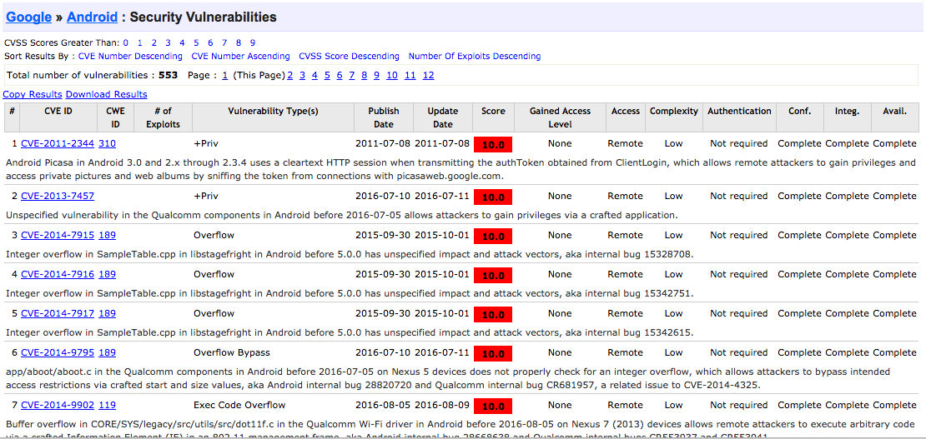
What would happen if your phone was hacked?
It’s happened before!

Slide 30
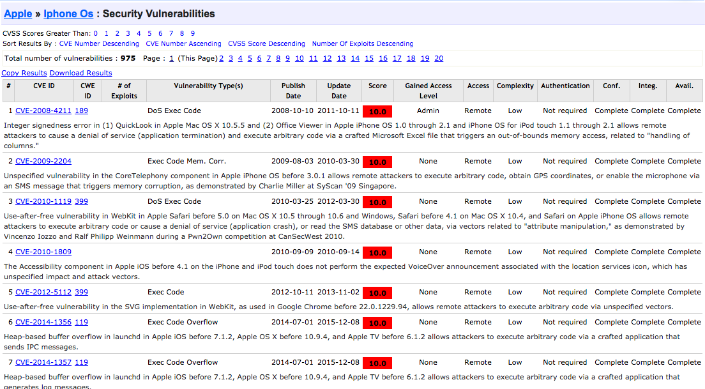
What would happen if your phone was hacked?
Even on Apple – that’s how jailbreaking works…

Slide 31
What would happen if your phone was hacked?
‘execute code’, ‘remote’

Slide 32
What would happen if your phone was hacked?

Slide 33
What would happen if your phone was hacked?
Your messages
Your locations
Your pictures
Your calendar
Your saved passwords
Your browsing history
Websites you’re logged into

Slide 34
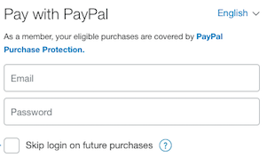

What would happen if your life was hacked?

Slide 35
Any questions?

